Slide 1
House Price Prediction App
Laboratorio di Informatica Applicata Final Project
Riommi Filippo – 13/01/2026

Slide 2
Problem and Objectives
Predict house prices based on real training data taken from Kaggle Housing Prices Competition dataset.
Explore dataset information through an EDA page with statistics and plots.
Train regression machine learning models interactively by choosing which features of the dataset and what regression model to use between four available.
Make predictions using saved models by inserting values in model’s features.

Slide 3
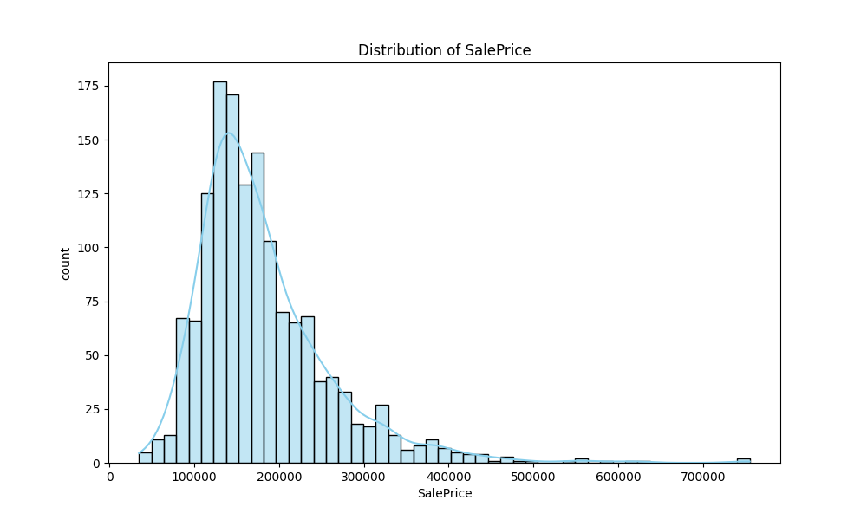
Data Analysis (EDA)
79 features (plus an ID and the target variable), representing different aspects of a house.
Price of houses (SalePrice) as the target variable.
Gaussian trend with a mean value between 100000 and 200000.

Slide 4


Missing Values
Most of NA values refer to the absence of the features.
Most houses have not expensive structures.
Most of these are categorical features, with the only exceptions of Lot Frontage, Masonry Area and Garage Construction Year.
Lot Frontage is a feature every house surely have, so NA values mean lack of information.
Features | NA Count | NA Percentage (%)
Pool Quality | 1453 | 99,5
Other Structures | 1406 | 96,3
Alley | 1369 | 93,8
Fence | 1179 | 80,8
Masonry Type | 872 | 59,7
Fireplace Quality | 690 | 47,2
Lot Frontage | 259 | 17,7
Garage Type | 81 | 5,5
Garage Construction Year | 81 | 5,5
Finished Garage | 81 | 5,5
Garage Quality | 81 | 5,5
Garage Condition | 81 | 5,5
Basement Exposure | 38 | 2,6
Second Basement Type | 38 | 2,6
Basement Quality | 37 | 2,5
Basement Condition | 37 | 2,5
First Basement Type | 37 | 2,5
Masonry Area | 8 | 0,5
Electrical | 1 | 0,07

Slide 5
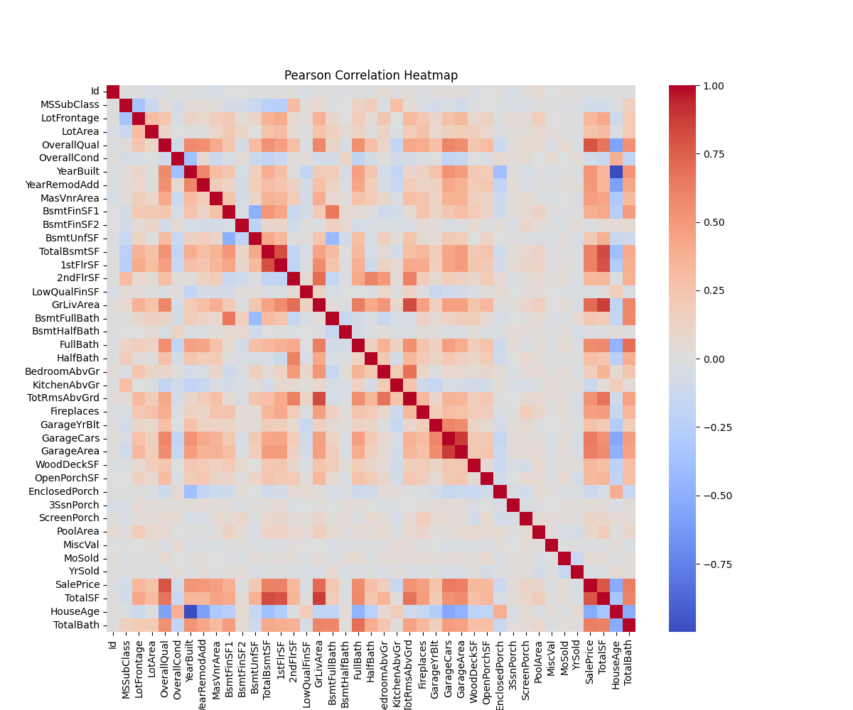
Derived Features and Correlations
High correlation for derived features.
Numeric features highest correlations:
Overall Quality
Living Area
Garage Area
Total Basement Area
Year Built
Number of Full Baths
Categorical features highest correlations:
Neighborhood
Exterior Quality
Kitchen Quality
Basement Quality
Sale Condition
House Style

Slide 6
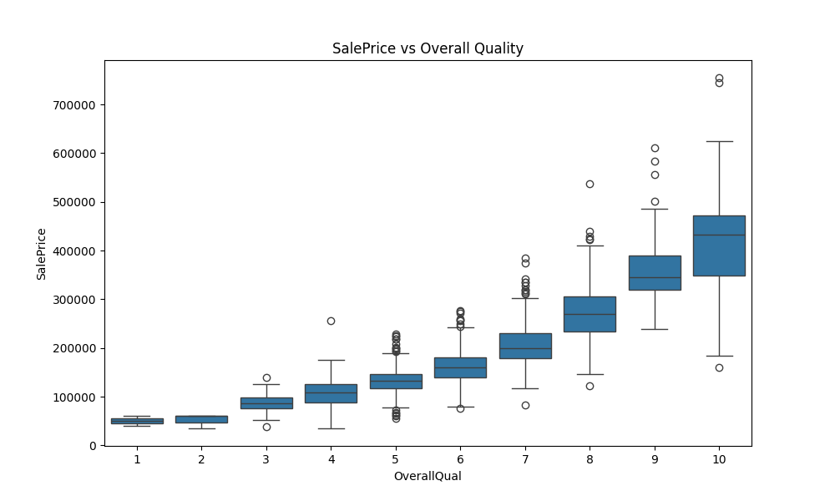
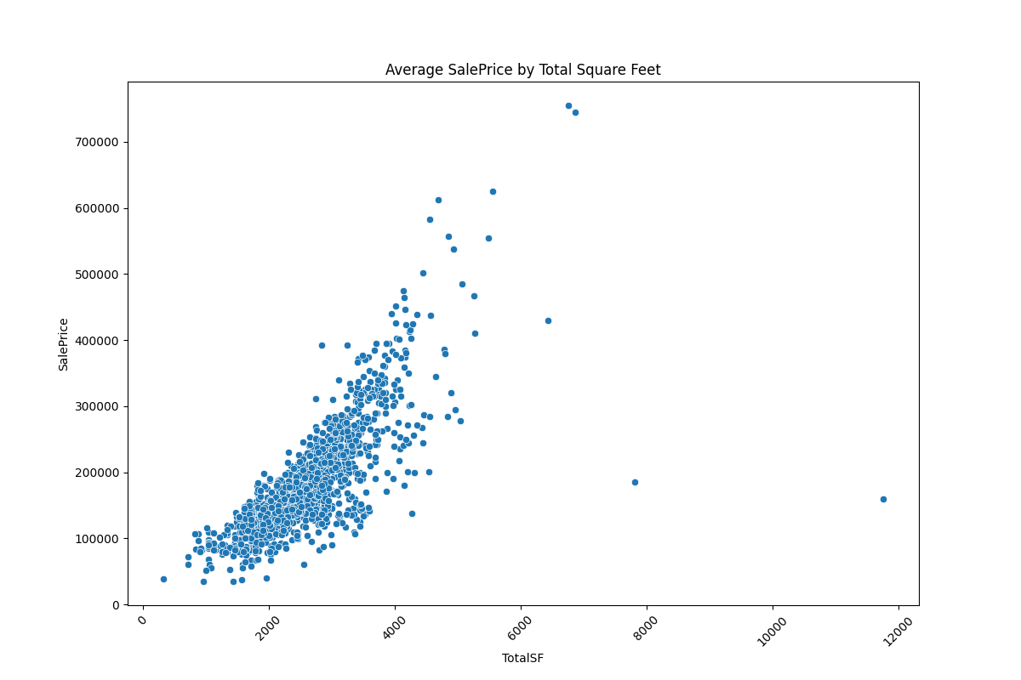
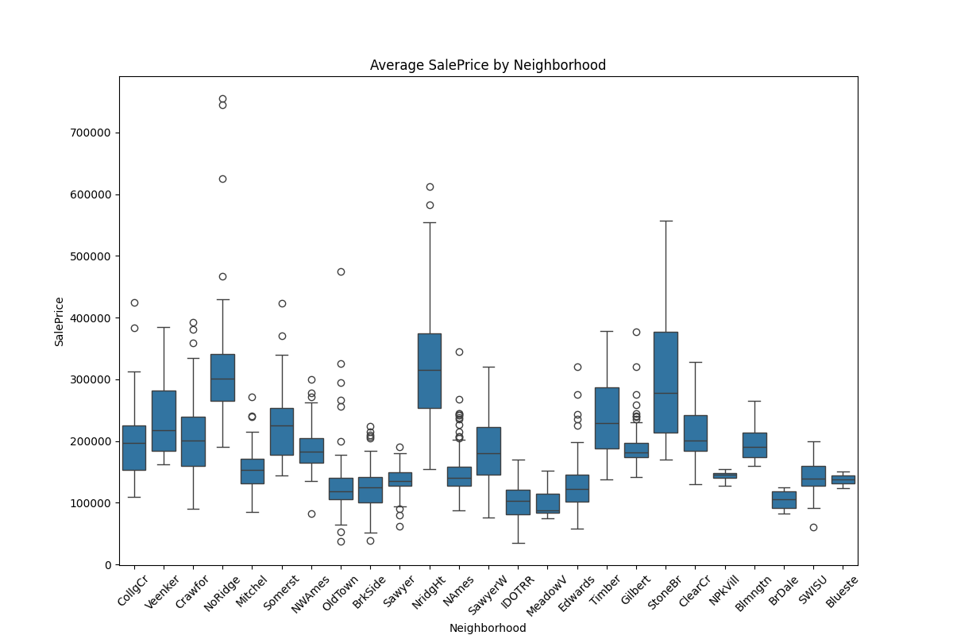
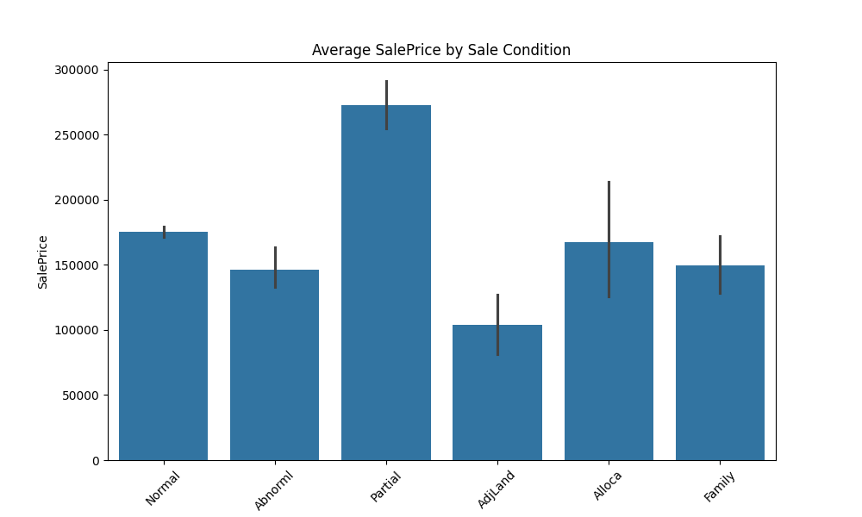
Plots

Slide 7
Insights
Structures like pool, fence or similar (although rare) tend to increase the price more than basic structures like garage or basement.
Quality is a bit more important than size: although dimensions are, of course, a relevant parameter to increase the price, the quality of amenities and the general quality has a slightly stronger impact on it.
Neighborhood is a strong indicator (but not absolute) of whether a house will have a high price or not (as expected).
There are some special sale conditions that pose themselves as exceptions; for example, big houses sold still unfinished have a low price compared to their sheer dimensions. Houses sold under normal conditions tend to have higher prices.
Other outliers are big yet poor-quality houses.

Slide 8
Machine Learning Methodology
Four different regression models to do the training:
Linear Regressor
Gradient Descent Regressor
Random Forest Regressor
Gradient Boosting Regressor
Data split into a training set (80) and a test set (20).
Preprocessing applied through a “Pipeline” object.
Preprocessing to NA values the same seen in EDA section.
Scaling and encoding for numeric and categorical features.
RMSE and R^2 as evaluation metrics.

Slide 9
Machine Learning Results
Linear Regressor with all features:
RMSE: 65277.26
R^2: 0.44
Linear Regressor with h-c features:
RMSE: 32987.23
R^2: 0.85
Gradient Descent Regressor with all features:
RMSE: 30878.29
R^2: 0.87
Gradient Descent Regressor with h-c features:
RMSE: 32702.34
R^2: 0.86
Random Forest Regressor with all features:
RMSE: 28855.86
R^2: 0.89
Random Forest Regressor with h-c features:
RMSE: 30695.02
R^2: 0.87
Gradient Boosting Regressor with all features:
RMSE: 28204.30
R^2: 0.89
Gradient Boosting Regressor with h-c features:
RMSE: 26757.47
R^2: 0.90

Slide 10
Implementation
5 html pages, each provided with a CSS stylesheet.
JavaScript file to collect input data and send them to the server through AJAX messages.
Main server structure realized using Flask as server.
EDA done with libraries such as Pandas, NumPy, Matplotlib and Seaborn; ML via Scikit-learn library.
Dataset stored in a CSV file.
Models saved as ‘.pkl’ files.
Models’ metadata in the ‘models.json’ file.
Dockerfile to install all requirement and create the container.
Docker-compose to launch and search for the first free port (starting from the port 5000) to run the application on.

Slide 11
Challenges Encountered and Solutions
Applying multiple preprocessing actions to data before training and predicting maintaining consistency -> Resolved using Pipelines to automate the preprocessing.
Saving trained model to use them later for predictions -> Resolved using Joblib to serialize the model in ‘.pkl’ files and load it on need; also, saving model metadata in a Json file.
Handling docker exposed port in case a fixed port is occupied -> Resolved using dynamic port selection in docker-compose file.
Applying preprocessing to dataset rows with NA values -> Resolved studying the nature of NA values for each feature using documentation and filling them consequently.

Slide 12
Possible Future Improvements
Add new regression models to further extend user possibilities.
Add dataset selection on training page to allow users to train models based on different datasets.
Add CSV file input to perform multiple predictions at once.
Add user authentication to save different models for different users.

